Slide 1
One Way Anova

Slide 2
Suppose a salesperson wants to compare the level of satisfaction of customers for four difference insurance companies.
Our question is:
"Is there a difference in satisfaction scores across the four difference insurance companies?”

Slide 3
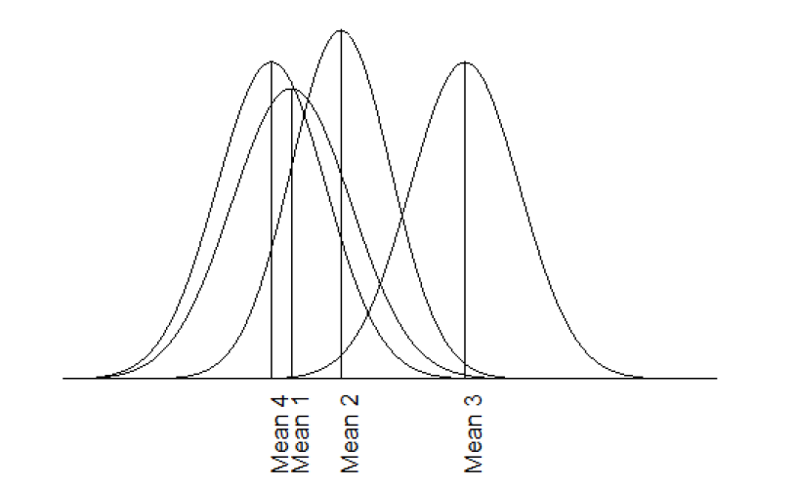

Slide 4
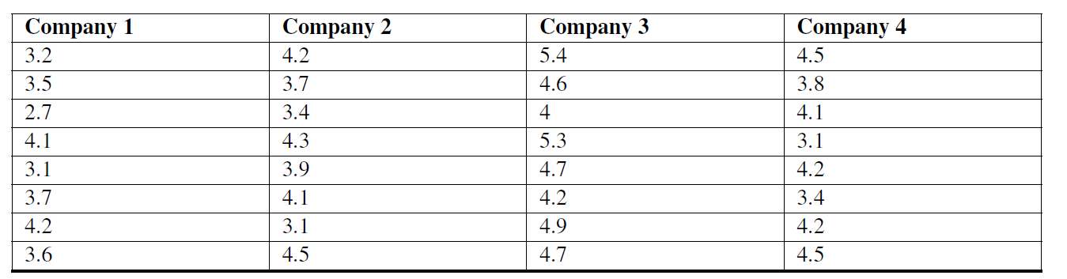

Slide 5
The Null and Alternative hypotheses for a one-way ANOVA can be written as:
H0 : Means of all factor levels are equal
HA : At least one factor level has a different mean

Slide 6
Assumptions of the ANOVA test
All observations are independent of one another and randomly selected from the population which they represent.
The population at each factor level is approximately normal.
The variances for each factor level are approximately equal to one another.

Slide 7
In ANOVA method, we analyze the total variation of the scores, including the variation of the scores within the groups and the variation between the group means.
Since we are interested in two different types of variation, we first calculate each type of variation independently and then calculate the ratio between the two –called an F-value.
Just like our z-score, our t-test, and chi-square tests, ANOVA has its own distribution that we need to use, called an F-distribution to set our critical values and test our hypothesis.

Slide 8
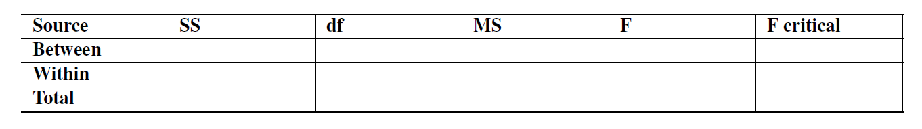

Slide 9

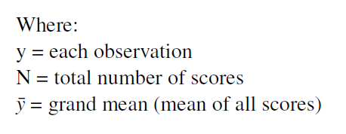
Calculate the total sum of squares (SST ). This is the difference between each score and the grand mean.
We use the following formula:

Slide 10
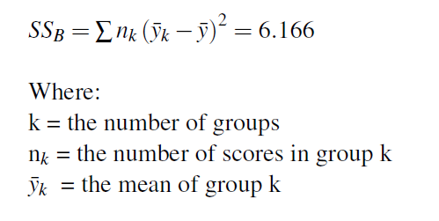
Calculate the sum of squares between (SSB).
We use the following formula:

Slide 11
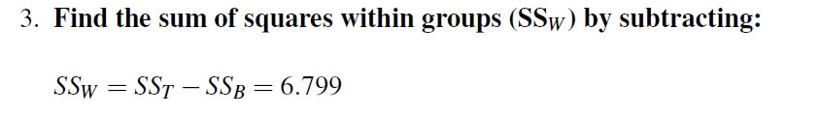

Slide 12
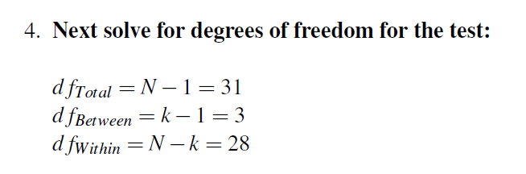

Slide 13
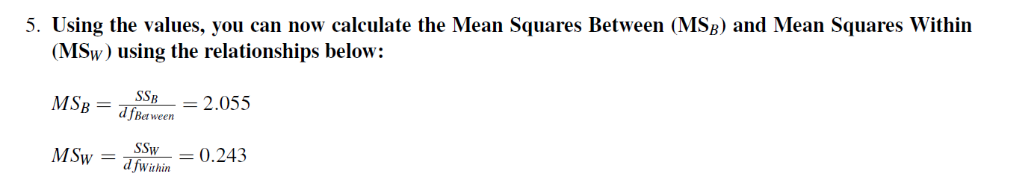

Slide 14
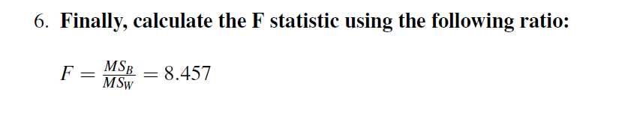

Slide 16
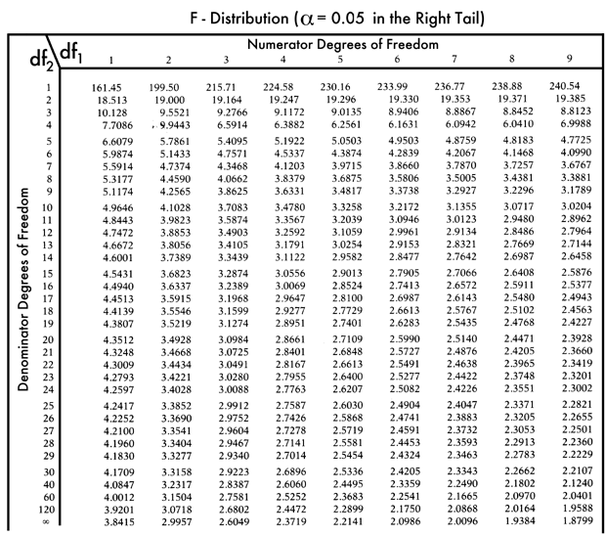

Slide 17
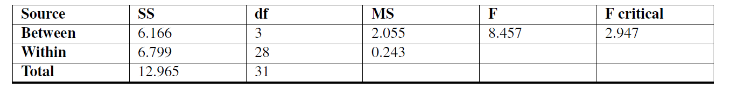

Slide 18
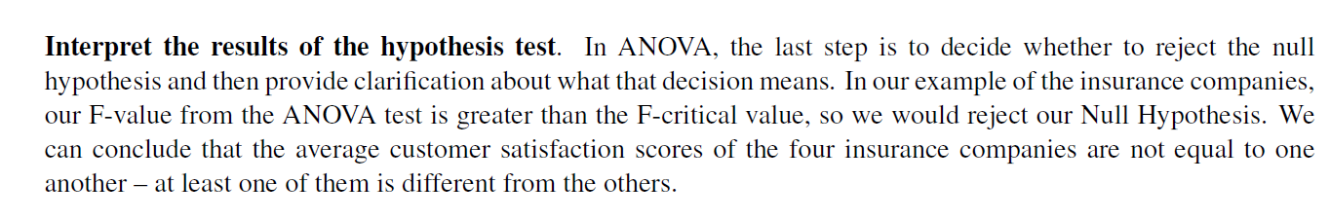

Slide 19
where the difference in the sample means lies
If we have an ANOVA that rejects the Null Hypothesis we must find out where the difference lies –what group or groups are difference from one another.
To do this we use a post-hoc test.

Slide 20
data(iris)
your.aov = aov(iris$Sepal.Length ~ iris$Species)
summary(your.aov)
TukeyHSD(your.aov)
aggregate(Sepal.Length~Species, data=iris, mean)

Slide 21
How strongly are sales related to advertising expenditure?
Is there association between market share and size of the sales force?

Slide 22
Correlation Analysis
Relationship/Association b/w continuous variable
The correlation between two variables can be positive or negative or zero.
There may be a non-linear association between two continuous variables, but computation of a correlation coefficient does not detect this.
slope

Slide 23
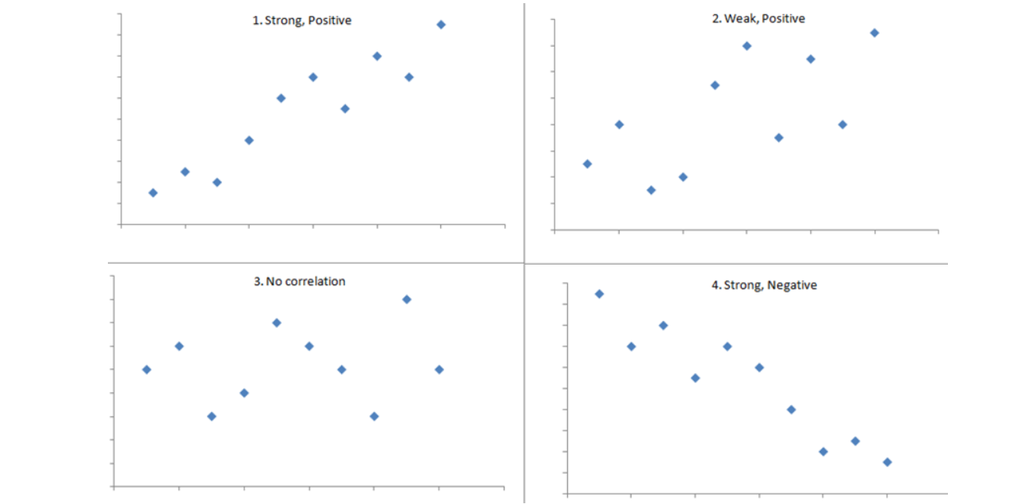

Slide 24




Slide 25
ggplot(data=mtcars, aes(x=disp, y=mpg))+geom_point(size=2)
cor(mtcars$mpg, mtcars$disp)

Slide 26
What will be adv. budget for 5000 RS sales?

Slide 27
Regression Analysis
Relationship between two or more variables so that we can gain information about one of them through knowing values of the other
Regression can be used for prediction, estimation

Slide 28
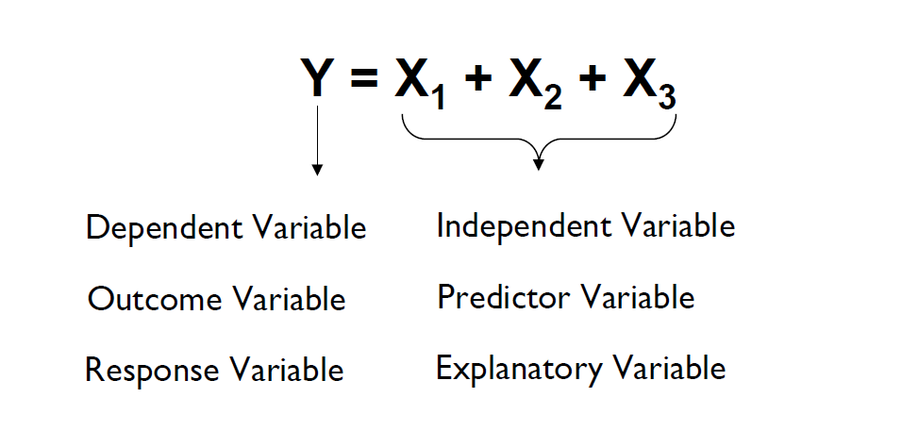

Slide 29
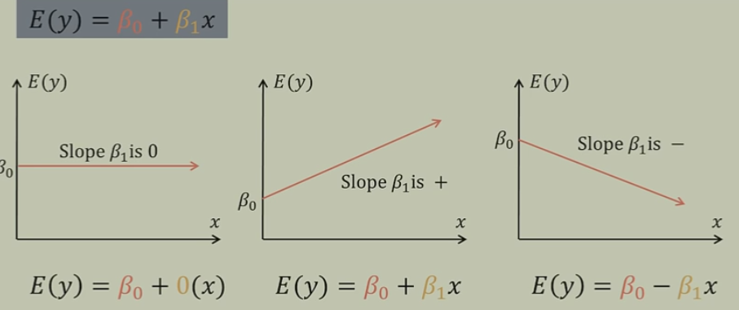

Slide 30
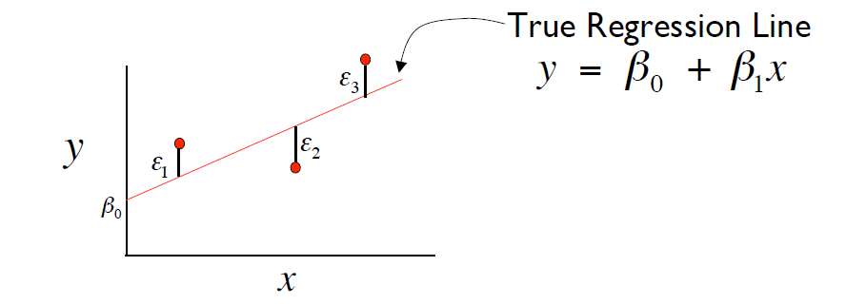
Least squares estimation
Determines the best fit line by minimizing the square of the vertical distance of all the points from the line.
Sum of square error

Slide 31
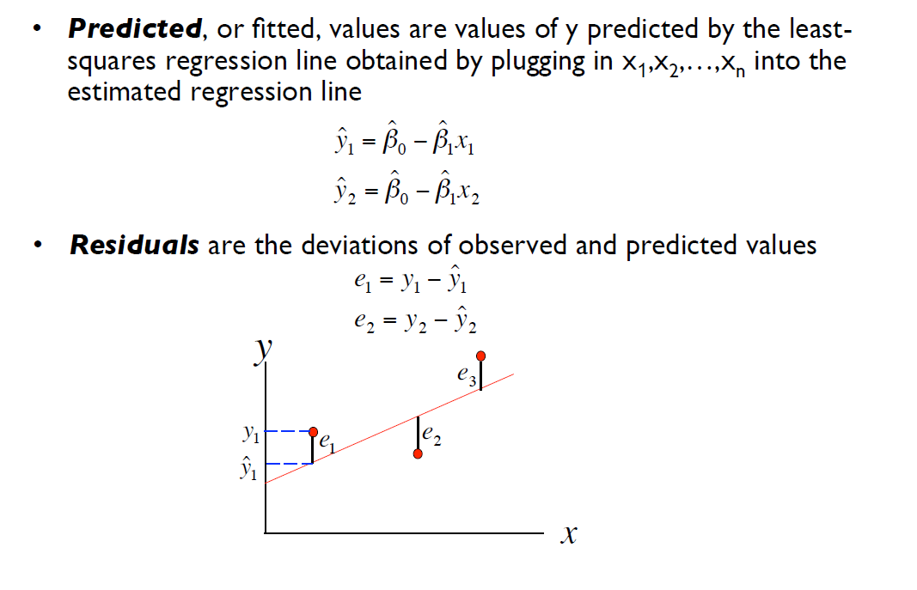

Slide 32
